Slide 1
All Pairs Shortest Path Algorithms

Slide 2
Instructor
Dr. Ab Rouf Khan
Assistant Professor
VIT Bhopal University

Slide 3
Entry level Questions
How are the various connections on the social media between the people represented?
Can we find a minimal path from every node to some other node in a graph?
Are trees and graphs one and the same thing?

Slide 4
Outline
All pairs shortest path algorithms
Dijkstra’s Algorithm
Bellman – Ford Algorithm

Slide 5
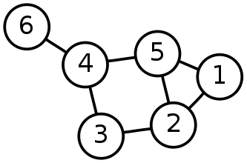
Single-Source Shortest Path Problem
Single-Source Shortest Path Problem - The problem of finding shortest paths from a source vertex v to all other vertices in the graph.

Slide 6
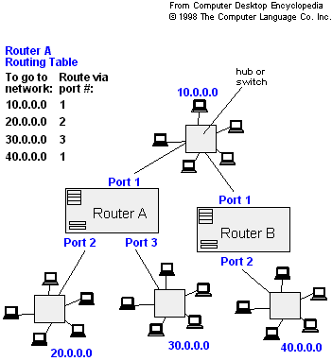
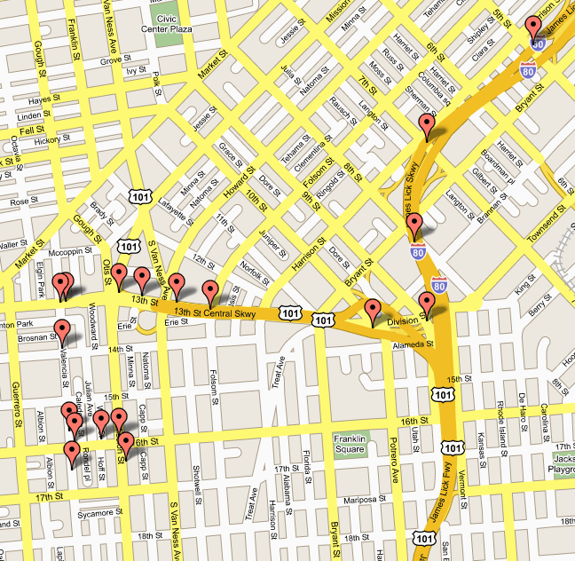
Applications
Maps (Map Quest, Google Maps)
Routing Systems

Slide 7
Dijkstra's algorithm
Dijkstra's algorithm - is a solution to the single-source shortest path problem in graph theory.
Works on both directed and undirected graphs. However, all edges must have nonnegative weights.
Input: Weighted graph G={E,V} and source vertex v∈V, such that all edge weights are nonnegative
Output: Lengths of shortest paths (or the shortest paths themselves) from a given source vertex v∈V to all other vertices

Slide 8
Approach
The algorithm computes for each vertex u the distance to u from the start vertex v, that is, the weight of a shortest path between v and u.
the algorithm keeps track of the set of vertices for which the distance has been computed, called the cloud C
Every vertex has a label D associated with it. For any vertex u, D[u] stores an approximation of the distance between v and u. The algorithm will update a D[u] value when it finds a shorter path from v to u.
When a vertex u is added to the cloud, its label D[u] is equal to the actual (final) distance between the starting vertex v and vertex u.

Slide 9
Dijkstra's pseudocode
Dijkstra(v1, v2):
for each vertex v: // Initialization
v's distance := infinity.
v's previous := none.
v1's distance := 0.
List := {all vertices}.
while List is not empty:
v := remove List vertex with minimum distance.
mark v as known.
for each unknown neighbor n of v:
dist := v's distance + edge (v, n)'s weight.
if dist is smaller than n's distance:
n's distance := dist.
n's previous := v.
reconstruct path from v2 back to v1, following previous pointers.

Slide 10
Example: Initialization
0
∞
Distance(source) = 0
Distance (all vertices but source) = ∞
A
2
B
4
1
3
10
∞
C
2
D
2
E
∞
5
8
∞
4
6
F
1
G
∞
∞
Pick vertex in List with minimum distance.

Slide 11
Example: Update neighbors' distance
0
2
A
2
B
4
1
3
10
∞
C
2
D
2
E
∞
5
8
1
4
6
Distance(B) = 2
F
1
G
Distance(D) = 1
∞
∞

Slide 12
Example: Remove vertex with minimum distance
0
2
A
2
B
4
1
3
10
∞
C
2
D
2
E
∞
5
8
1
4
6
F
1
G
∞
∞
Pick vertex in List with minimum distance, i.e., D

Slide 13
Example: Update neighbors
0
2
A
2
B
4
1
3
10
3
C
2
D
2
E
3
5
8
1
4
6
Distance(C) = 1 + 2 = 3 Distance(E) = 1 + 2 = 3 Distance(F) = 1 + 8 = 9 Distance(G) = 1 + 4 = 5
F
1
G
9
5

Slide 14
Example: Continued ...
Pick vertex in List with minimum distance (B) and update neighbors
0
2
A
2
B
4
1
3
10
3
C
2
D
2
E
3
5
8
1
4
6
Note : distance(D) not updated since D is already known and distance(E) not updated since it is larger than previously computed.
F
1
G
9
5

Slide 15
Example: Continued...
Pick vertex List with minimum distance (E) and update neighbors
0
2
A
2
B
4
1
3
10
3
C
2
D
2
E
3
5
8
1
4
6
F
1
G
No updating
9
5

Slide 16
Example: Continued...
Pick vertex List with minimum distance (C) and update neighbors
0
2
A
2
B
4
1
3
10
3
C
2
D
2
E
3
5
8
1
4
6
Distance(F) = 3 + 5 = 8
F
1
G
8
5

Slide 17
Example: Continued...
Pick vertex List with minimum distance (G) and update neighbors
0
2
A
2
B
4
1
3
10
3
C
2
D
2
E
3
5
8
1
4
6
F
1
G
Previous distance
6
5
Distance(F) = min (8, (5+1)) = 6

Slide 18
Example (end)
0
2
A
2
B
4
1
3
10
3
C
2
D
2
E
3
5
8
1
4
6
F
1
G
6
5
Pick vertex not in S with lowest cost (F) and update neighbors

Slide 19
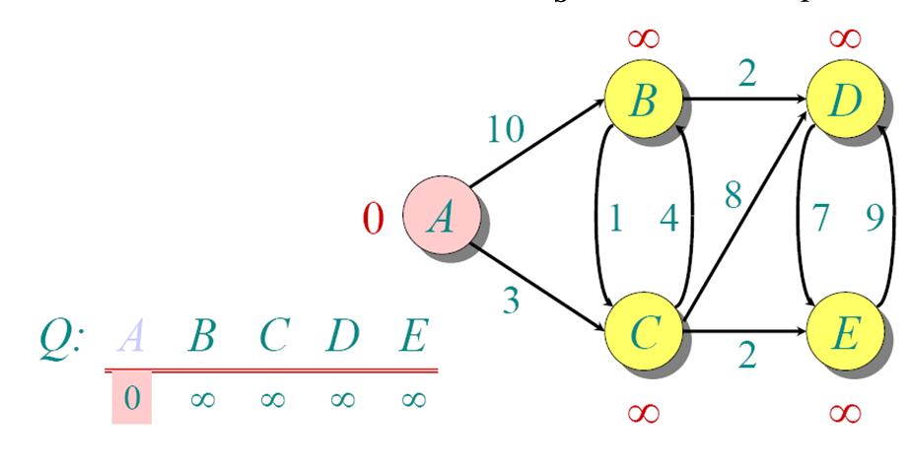
Example (2)

Slide 20
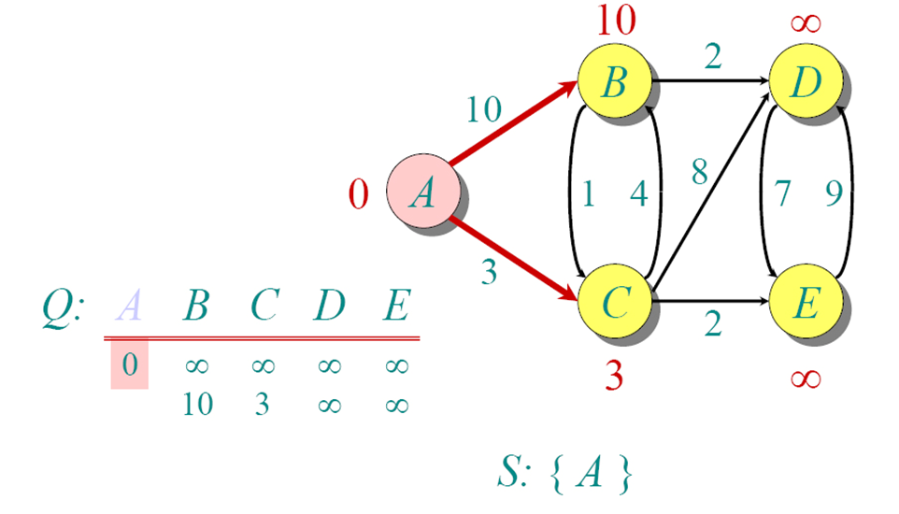
Example (2)

Slide 21
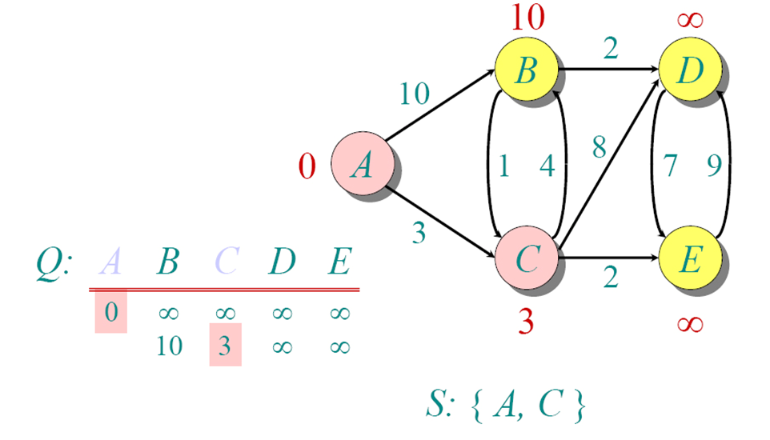
Example (2)

Slide 22
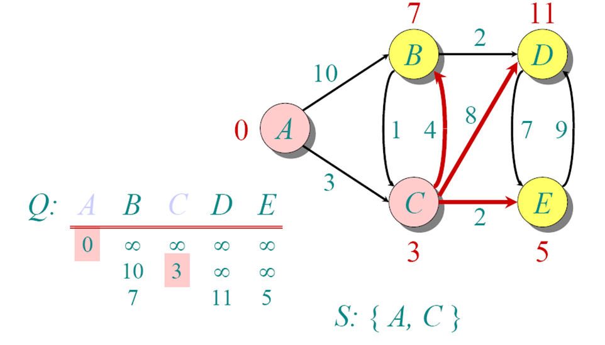
Example (2)

Slide 23
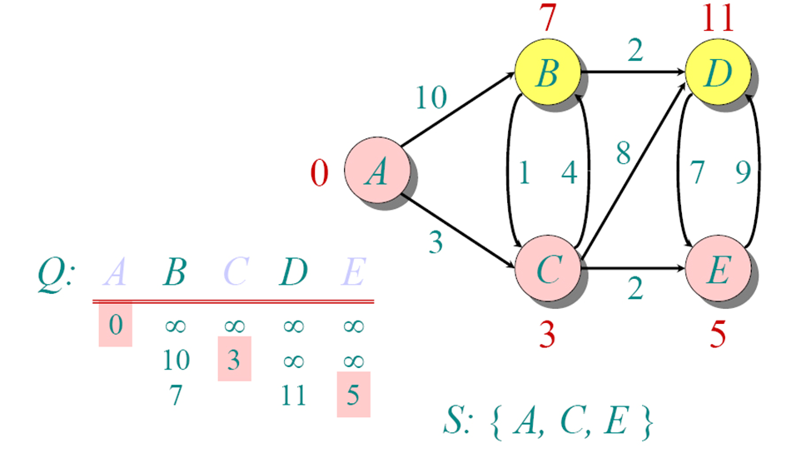
Example (2)

Slide 24
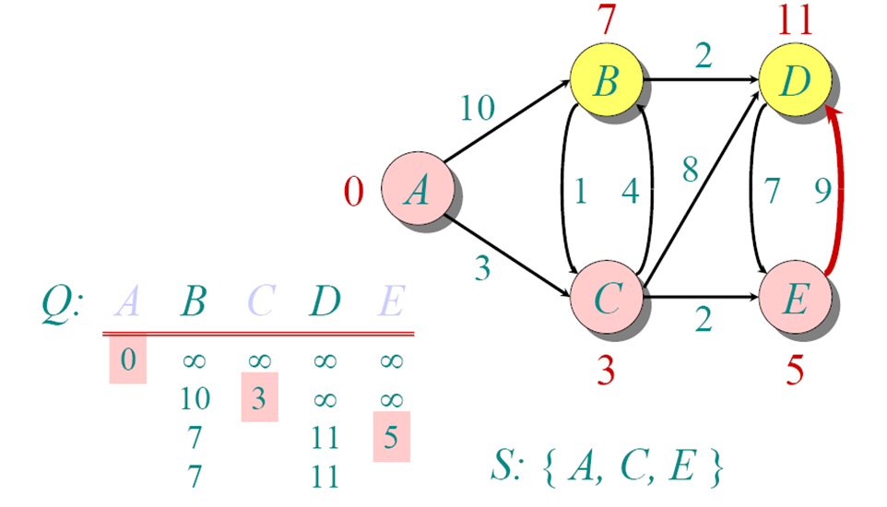
Example (2)

Slide 25
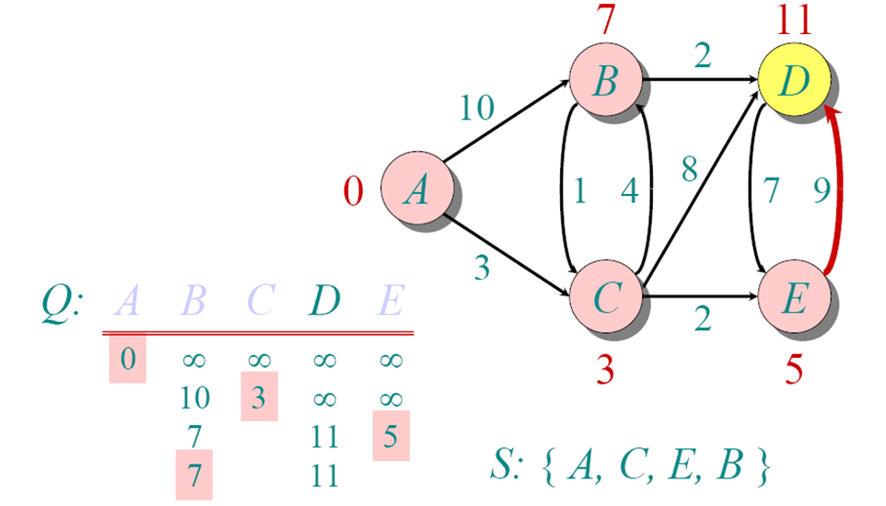
Example (2)

Slide 26
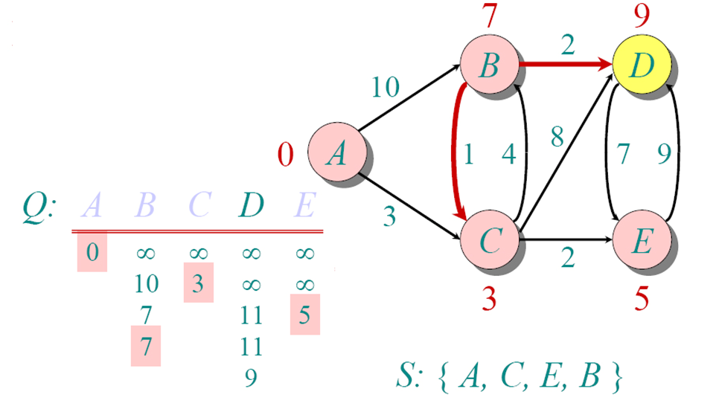
Example (2)

Slide 27
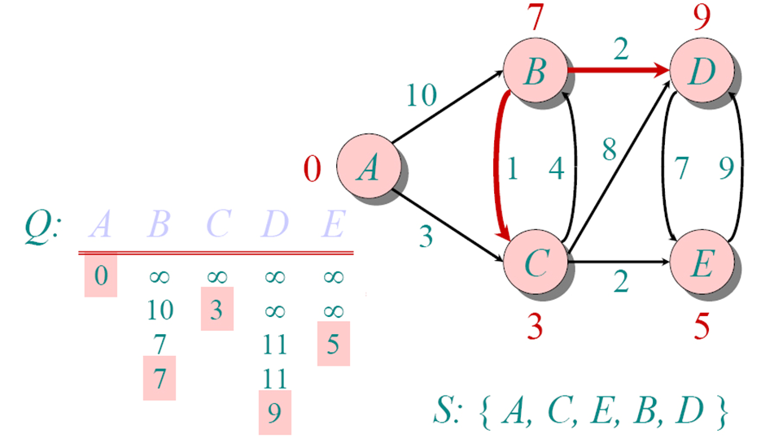
Example (2)

Slide 28
Example (3)
D(v)
p(v)
D(w)
p(w)
D(x)
p(x)
D(y)
p(y)
D(z)
p(z)
Step
N'
0
u
7,u
3,u
5,u
∞
∞
1
uw
6,w
5,u
11,w
∞
2
uwx
6,w
11,w
14,x
3
uwxv
10,v
14,x
4
uwxvy
12,y
5
uwxvyz
x
9
notes:
construct shortest path tree by tracing predecessor nodes
ties can exist (can be broken arbitrarily)
5
7
4
8
u
3
w
y
z
2
3
7
4
v

Slide 29
Dijkstra’s Algorithm (Pseudocode)
1 Initialization:
2 N' = {u}
3 for all nodes v
4 if v adjacent to u
5 then D(v) = c(u,v)
6 else D(v) = ∞
7
8 Loop
9 find w not in N' such that D(w) is a minimum
10 add w to N'
11 update D(v) for all v adjacent to w and not in N' :
12 D(v) = min( D(v), D(w) + c(w,v) )
13 /* new cost to v is either old cost to v or known
14 shortest path cost to w plus cost from w to v */
15 until all nodes in N'

Slide 30
Time Complexity: Using List
The simplest implementation of the Dijkstra's algorithm stores vertices in an ordinary linked list or array
Good for dense graphs (many edges)
|V| vertices and |E| edges
Initialization O(|V|)
While loop O(|V|)
Find and remove min distance vertices O(|V|)
Potentially |E| updates
Update costs O(1)
Total time O(|V²| + |E|) = O(|V²| )

Slide 31
Time Complexity: Priority Queue
For sparse graphs, (i.e. graphs with much less than |V²| edges) Dijkstra's implemented more efficiently by priority queue
Initialization O(|V|) using O(|V|) buildHeap
While loop O(|V|)
Find and remove min distance vertices O(log |V|) using O(log |V|) deleteMin
Potentially |E| updates
Update costs O(log |V|) using decreaseKey
Total time O(|V|log|V| + |E|log|V|) = O(|E|log|V|)
|V| = O(|E|) assuming a connected graph

Slide 32
Bellman-Ford Algorithm
Bellman-Ford equation (dynamic programming)
let
d_{x}(y) := cost of least-cost path from x to y
then
d_{x}(y) = min {c(x,v) + d_{v}(y) }
v
cost from neighbor v to destination y
cost to neighbor v
min taken over all neighbors v of x

Slide 33
Bellman-Ford example
5
3
clearly, d_{v}(z) = 5, d_{x}(z) = 3, d_{w}(z) = 3
v
w
2
5
u
z
B-F equation says:
2
1
3
1
2
d_{u}(z) = min { c(u,v) + d_{v}(z),
c(u,x) + d_{x}(z),
c(u,w) + d_{w}(z) }
= min {2 + 5,
1 + 3,
5 + 3} = 4
x
y
1
node achieving minimum is next
hop in shortest path, used in forwarding table

Slide 34
Bellman-Ford – Distance vector algorithm
D_{x}(y) = estimate of least cost from x to y
x maintains distance vector D_{x} = [D_{x}(y): y є N ]
node x:
knows cost to each neighbor v: c(x,v)
maintains its neighbors’ distance vectors. For each neighbor v, x maintains D_{v} = [D_{v}(y): y є N ]

Slide 35
Bellman-Ford – Distance vector algorithm
key idea:
from time-to-time, each node sends its own distance vector estimate to neighbors
when x receives new DV estimate from neighbor, it updates its own DV using B-F equation:
D_{x}(y) ← min_{v}{c(x,v) + D_{v}(y)} for each node y ∊ N
under minor, natural conditions, the estimate D_{x}(y) converge to the actual least cost d_{x}(y)

Slide 36
Bellman-Ford – Distance vector algorithm
iterative, asynchronous: each local iteration caused by:
local link cost change
DV update message from neighbor
distributed:
each node notifies neighbors only when its DV changes
neighbors then notify their neighbors if necessary
each node:
wait for (change in local link cost or msg from neighbor)
recompute estimates
if DV to any dest has changed, notify neighbors

Slide 37
D_{x}(y) = min{c(x,y) + D_{y}(y), c(x,z) + D_{z}(y)} = min{2+0 , 7+1} = 2
D_{x}(z) = min{c(x,y) + D_{y}(z), c(x,z) + D_{z}(z)}
= min{2+1 , 7+0} = 3
node x
table
cost to
cost to
x y z
x y z
x
0 2 7
x
0
2
3
y
y
2 0 1
from
∞
∞
∞
from
z
∞
∞
∞
z
7 1 0
node y
table
cost to
x y z
y
Bellman-Ford – Example
2
1
x
∞
∞
z
∞
2 0 1
x
from
y
7
z
∞
∞
∞
node z
table
cost to
x y z
x
∞ ∞ ∞
from
y
∞
∞
∞
z
7
1
0
time

Slide 38
D_{x}(z) = min{c(x,y) + D_{y}(z), c(x,z) + D_{z}(z)}
= min{2+1 , 7+0} = 3
D_{x}(y) = min{c(x,y) + D_{y}(y), c(x,z) + D_{z}(y)} = min{2+0 , 7+1} = 2
node x
table
cost to
cost to
cost to
x y z
x y z
x y z
x
0 2 7
x
0
2
3
x
0 2 3
y
y
2 0 1
from
∞
∞
∞
from
y
2 0 1
z
z
from
∞
∞
∞
7 1 0
z
3 1 0
node y
table
cost to
cost to
cost to
x y z
x y z
x y z
y
Bellman-Ford – Example
2
1
x
∞
∞
x
0 2 7
∞
2 0 1
x
0 2 3
x
z
from
y
y
2 0 1
7
from
y
2 0 1
from
z
∞
∞
∞
z
7 1 0
z
3 1 0
node z
table
cost to
cost to
cost to
x y z
x y z
x y z
x
∞ ∞ ∞
x
0 2 7
x
0 2 3
y
y
2 0 1
from
y
∞
∞
from
2 0 1
from
∞
z
z
3 1 0
z
3 1 0
7
1
0
time
time

Slide 39
Bellman-Ford Algorithm
link cost changes:
node detects local link cost change
updates routing info, recalculates distance vector
if DV changes, notify neighbors
1
y
4
1
x
z
50
“good
news
travels
fast”
t₀ : y detects link-cost change, updates its DV, informs its neighbors.
t₁ : z receives update from y, updates its table, computes new least cost to x , sends its neighbors its DV.
t₂ : y receives z’s update, updates its distance table. y’s least costs do not change, so y does not send a message to z.

Slide 40
List of the Recommended Books for the DSA course
Data Structures
Data Structures Using C and C++, Langsam, Augenstein, Tenenbaum, Pearson.
Data Structures | Schaum's Outline Series, Seymour Lipschutz.
Algorithms
Introduction to Algorithms, Thomas H. Cormen, Charles E. Leiserson, Ronald L. Rivest, Clifford Stein, PHI.
The Algorithm Design Manual, Steven S Skiena, Springer.
General
Art of Computer Programming, Volumes 1-4A, Donald Knuth, Addison-Wesley

Slide 41

Recap

Slide 42
Thank You

